Slide 1
March 20
2025
message
co-
design
Notes:
Notes from discussion posts:
Positive disruptiveness of YPAR
What are the learning priorities of the youth
discussing and mapping out the level of engagement we could aim for during the rest of the semester
Planning data collection with our students

Slide 2
today’s agenda
1.
2.
3.
4.
5.
opening activity
5 minutes
co-design principles + processes
15 minutes
activity:
design the co-design
30 minutes
ethics discussion +
action items
~20 minutes
session 6 planning
~45 minutes
~5 min break!

Slide 3
opening activity!
abstract
SKETCH
ing
What does a good day look like?
What does a bad day look like?
Notes:
5 minutes

Slide 4
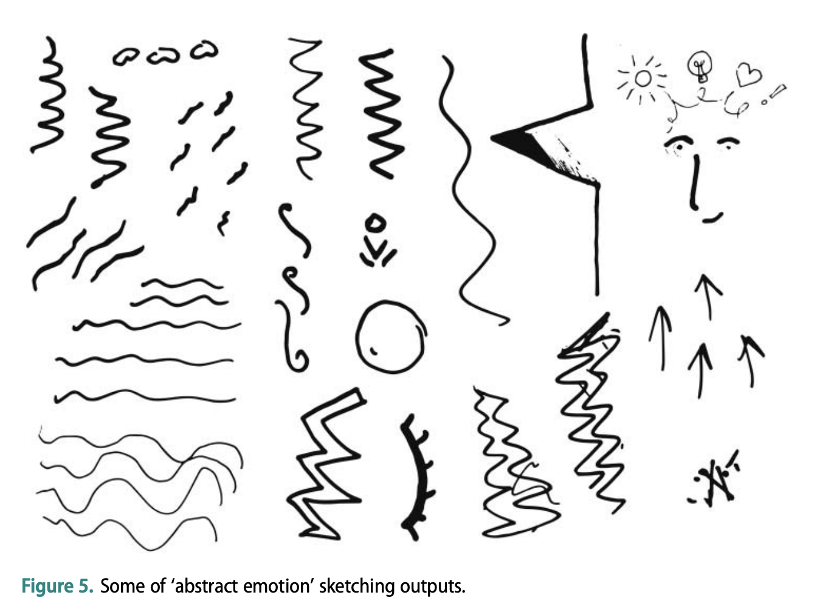
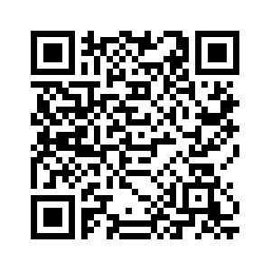
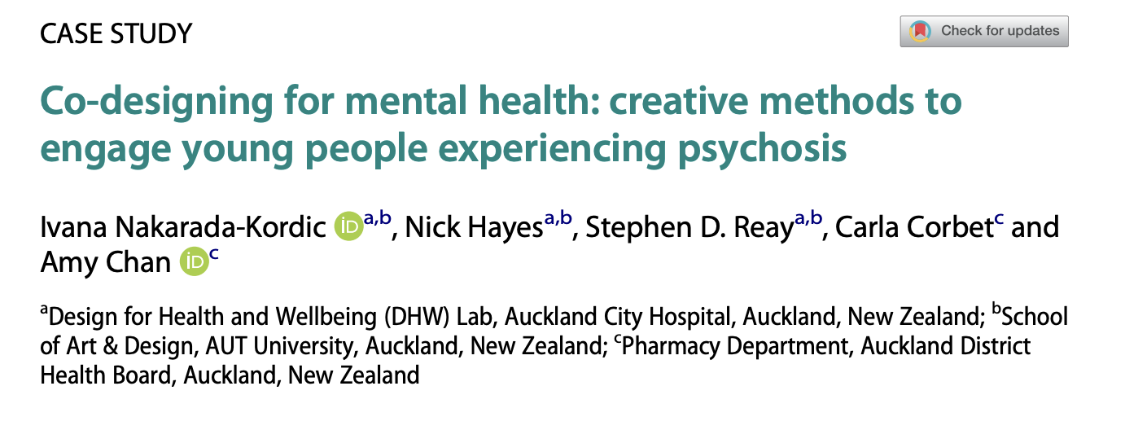
abstract sketching: a co-design icebreaker

Slide 5
what is co-design for?
programs and services
commatiounicn/
messaging campaigns
interventions
resource maps
apps, websites, or other tools and platforms
to → for → with
Notes:
30 seconds
Co-design: better interventions
positive empowerment
Aligns with principles and positive disruptiveness of YPAR

Slide 6
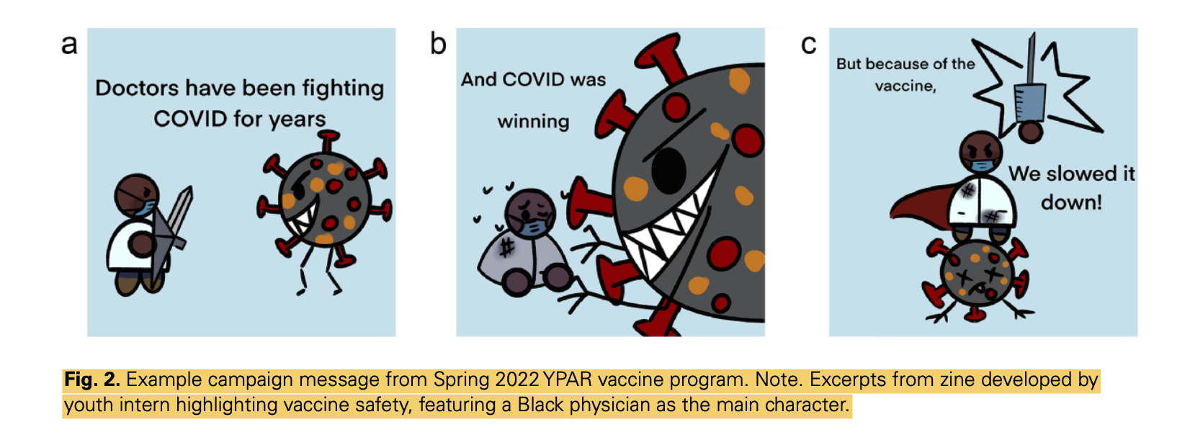
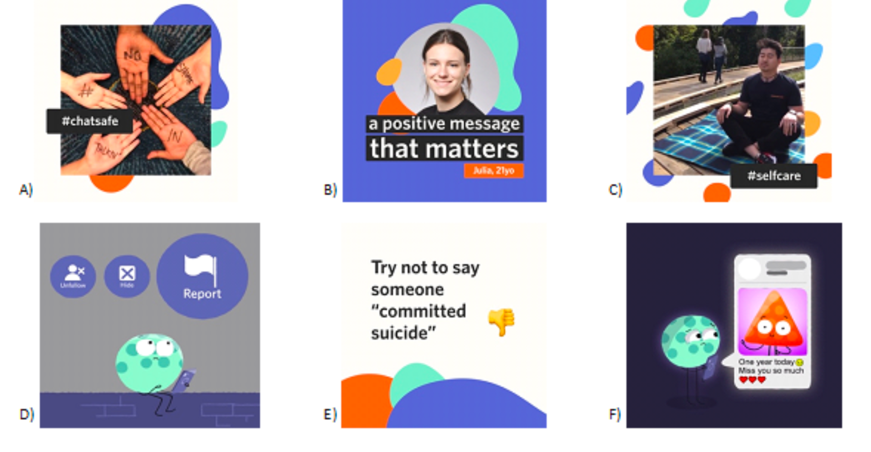
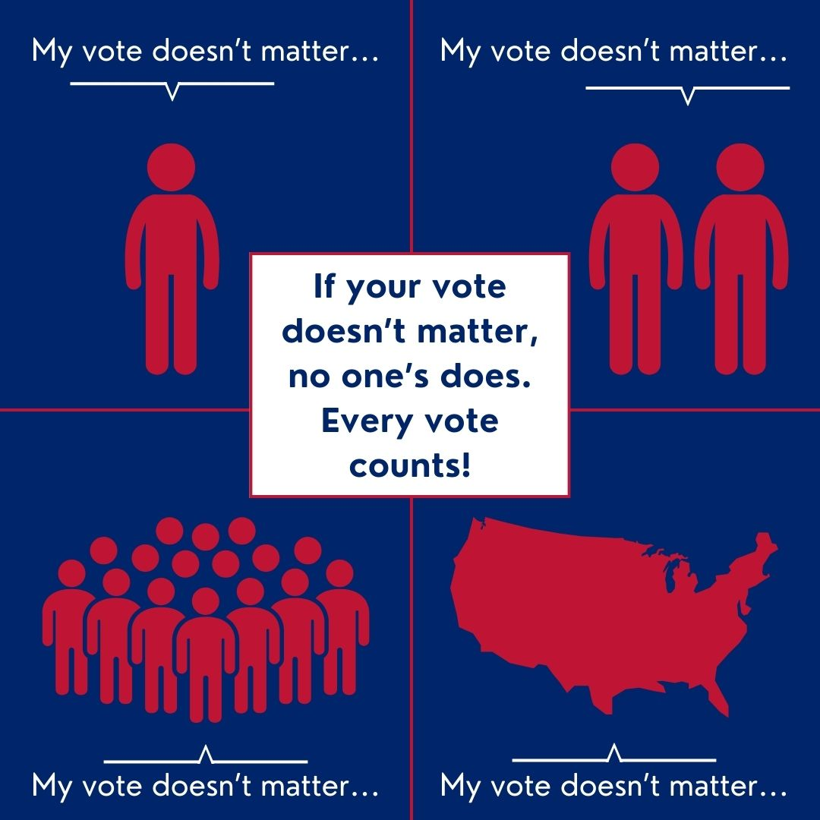
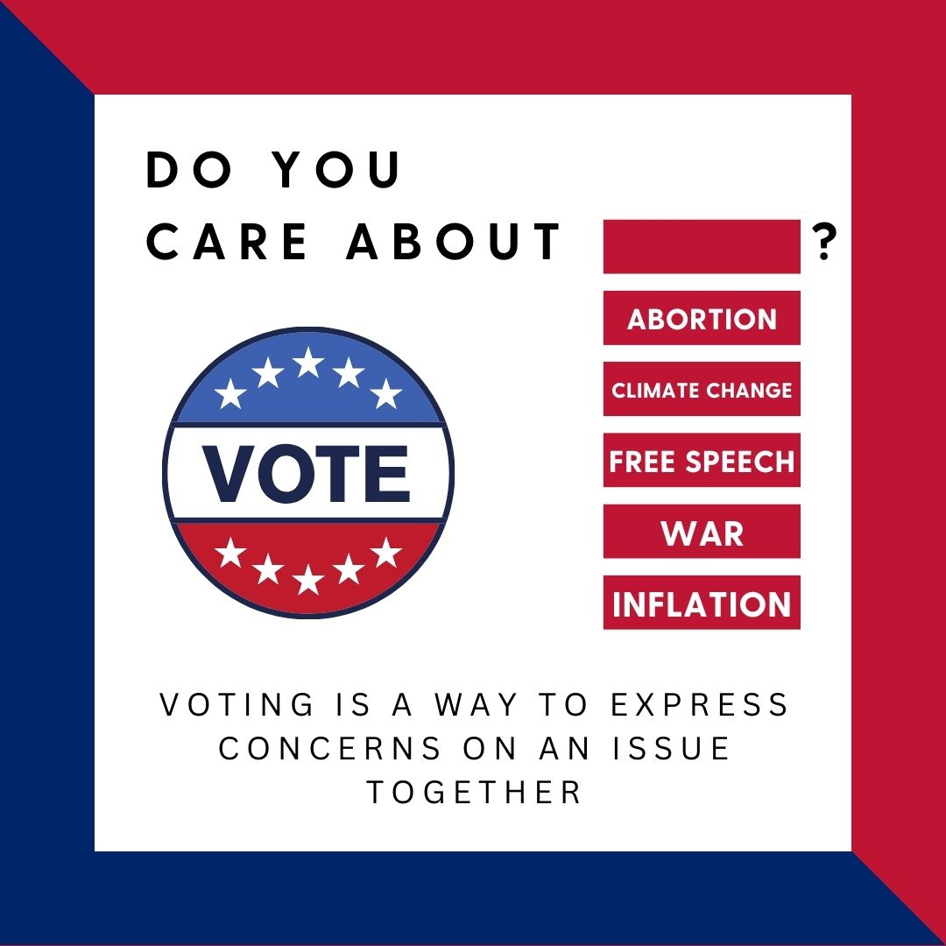
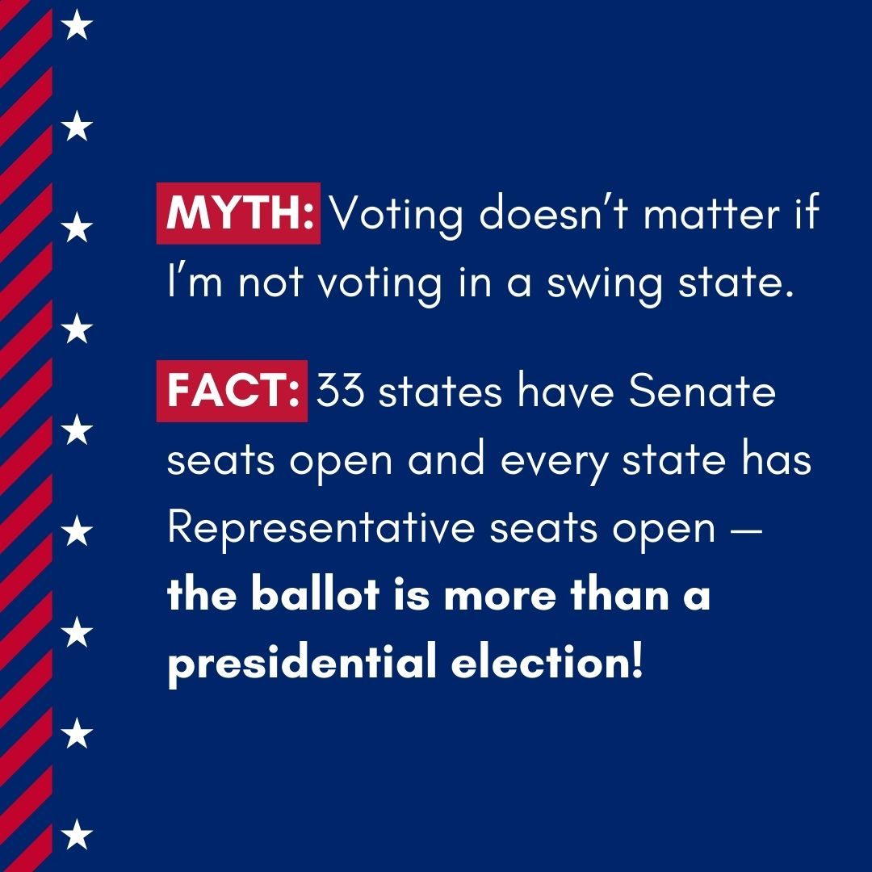

YPACR examples
Notes:
1 minute
TikTok video, a cartoon-style zine and photographed portraits.
Note design tool variability in thorn et al :
Scenes (physical and digital illustrations used to develop storyboards; Play Doh; Post-it notes, butcher’s paper, pencils, and colored markers; Lego; stickers; and iPads.

Slide 7
what are the key features of a co-design process?
Notes:
2 minutes
Shared decision-making power
Equally valuing all kinds of expertise
Active participation
Use of design tools and activities
Non-linearity

Slide 8
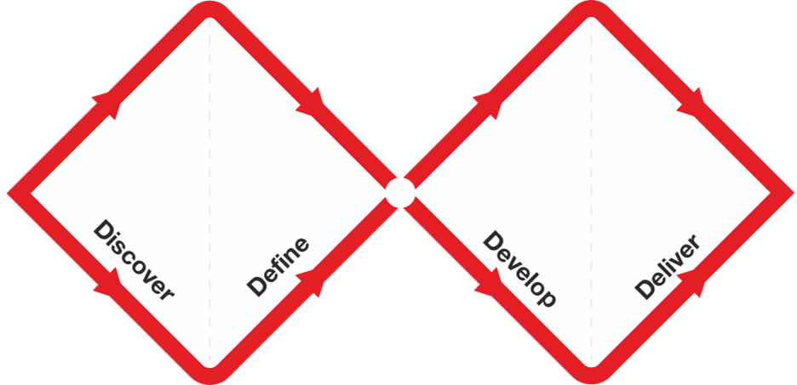
the double diamond process
divergence
convergence
where are we in this process?
where is our goal, for coming sessions?
Notes:
2 minutes
Identify (problem), define (target audience), position (framing, situating), concept (designing what), create and use
Iterative and cyclic process
For example, iterating from diverging or broad thinking to converging or decision-making
Mention iterative process in PLTV project
Note on timing from Thorn et al :
Of the 11 workshops, 3 had a define focus, 9 had a design focus, and 4 had a user-testing focus.
time-wise, our timeline is a little different, as Anicca noted in her discussion post.
Slower time bc we are integrating youth voice earlier in research process
10 minutes
Think pair share – where are we? Where do we want to be?
Let’s say we want to be working in the develop phase in our next session – are we ready for that phase? What do we need in order to get there in our next session if not?

Slide 9
designing design activity:
pick your….
category,
tools,
co-design elements
design icebreakers
storyboards
digital tools
legos
markers
post-its
???????
What’s your starting point? (problem defined? target audience defined? intervention type decided? content decided?)
Are youth creating the output themselves? What questions can they answer?
What’s the feedback + iteration process?
How are you implementing co-design principles?
messaging campaign
app / website / platform
resource map
programming
???????
…and map out a co-design activity! (25 minutes in groups + 20 minutes feedback/discussion altogether)
Notes:
Are we really tapping into the expertise of the youth / focusing enough on youth-specific issues?
Target audience —- should this be the youth themselves? (e.g. gun violence group thinking to target younger audience)

Slide 10
break
:)

Slide 11
ethics + safety
research aims → IRB approval?
sensitive topics + personal experiences
wellness plans + risk management protocols
action items
Notes:
Ethical issues of research / IRB approval
Negative impacts of discussing sensitive topics
Are we really tapping into the expertise of the youth / focusing enough on youth-specific issues?
We can tap more into lived experiences and feelings
Does this increase the riskiness / possible negative impact or sensitivity of conversation?
Relationship building is important to deal with this; but also providing resources and plans
We can ask students about affective impacts

Slide 12
group work
!!
(more action items!! - the rest of class)
Notes:
Recap ideas from last session / things we are planning (share-out briefly)
Time-maps per group
Plan next session

